Slide 1


Computer Assisted Diagnostics
Breast Tumor Biopsy Classification
Nicholas Lee, Nic Brathwaite, Amir Moayed

Slide 2
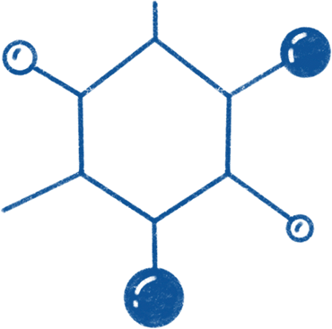
Table of contents
01
04
02
05
03
06
Introduction
Models
Breast Cancer
Binary and Multi-class CNN, ResNet
Data Prep
Discussion
Formating, Extraction, Dataset Creation
Hyperparameters
Feature Selection
Conclusions
Image Augmentation, TensorFlow
Results, Metrics

Slide 3


01
Introduction

Slide 4
Purpose statement
Diagnostic Assistant
Having a tool for pathologists and healthcare provides to assist in identifying types of tumors
Decrease Hands-on Time
Identifying key features from images of microscopes is tedious and time consuming. Decreasing hands-on time frees time for doctors to review key slides and finds from the model
Creating an Adaptive Tool
Biopsy slides stained for certain markers could identify key features which could be applied to other tissues and organs

Slide 5
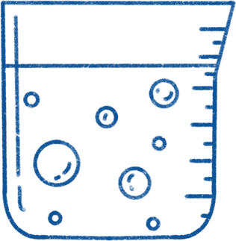
2,261,419
11.7 % of the 19,292,789 cancer cases reported by the World Health Organization in 2020
Survival: The 5- and 10-year relative survival rates are 91% and 85%, respectively, for invasive breast cancer
Notes:
https://www.cancer.org/content/dam/cancer-org/research/cancer-facts-and-statistics/annual-cancer-facts-and-figures/2023/2023-cancer-facts-and-figures.pdf

Slide 6
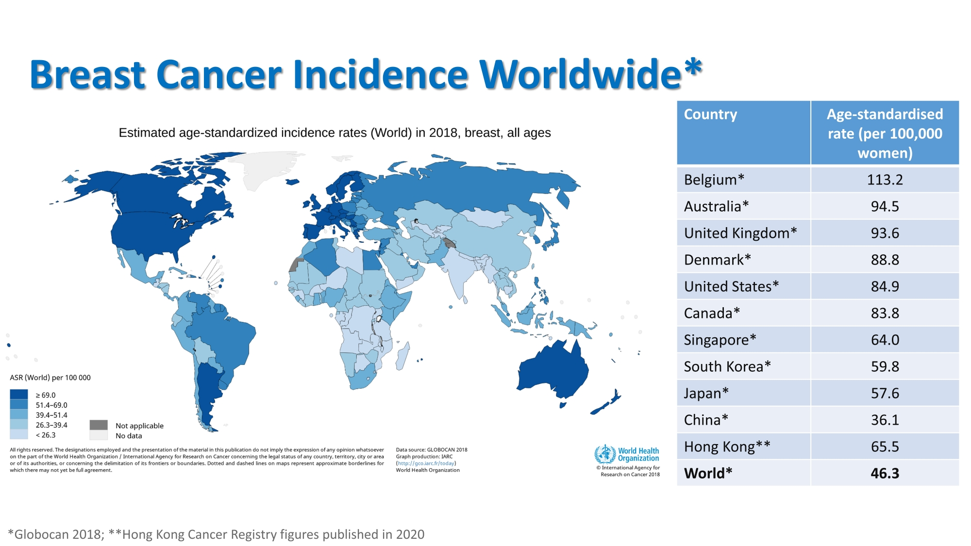
Notes:
https://www.hkbcf.org/en/breast_cancer/main/100/

Slide 7
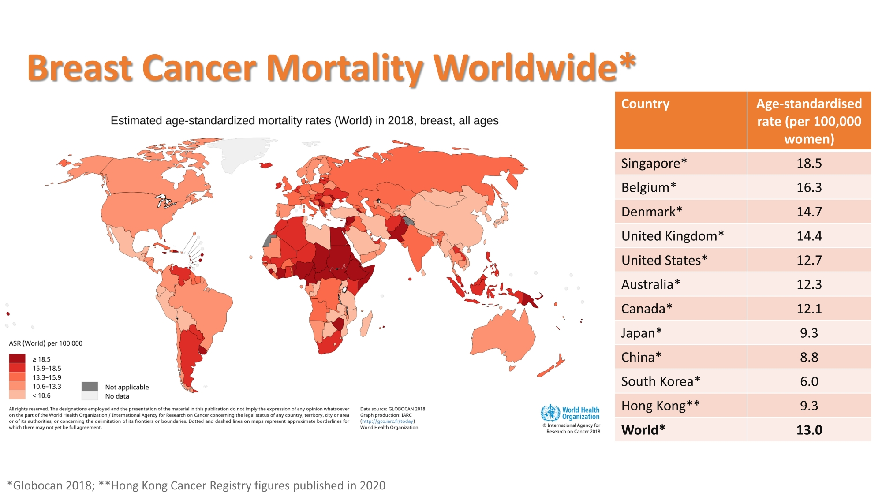
Notes:
https://www.hkbcf.org/en/breast_cancer/main/100/

Slide 8

Breast Cancer Histopathological Database
(BreakHis)

Slide 9
Classification Labels
Adenosis (A)
Phyllodes Tumor (PT)
Benign
Fibroadenoma (F)
Tubular Adenona (TA)
Tumor
Carcinoma (DC)
Lobular Carcinoma (LC)
Malignant
Mucinous Carcinoma (MC)
Papillary Carcinoma (PC)

Slide 10
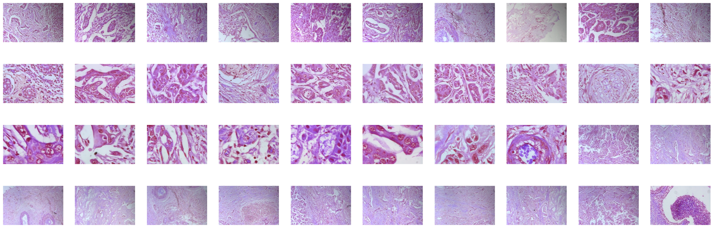
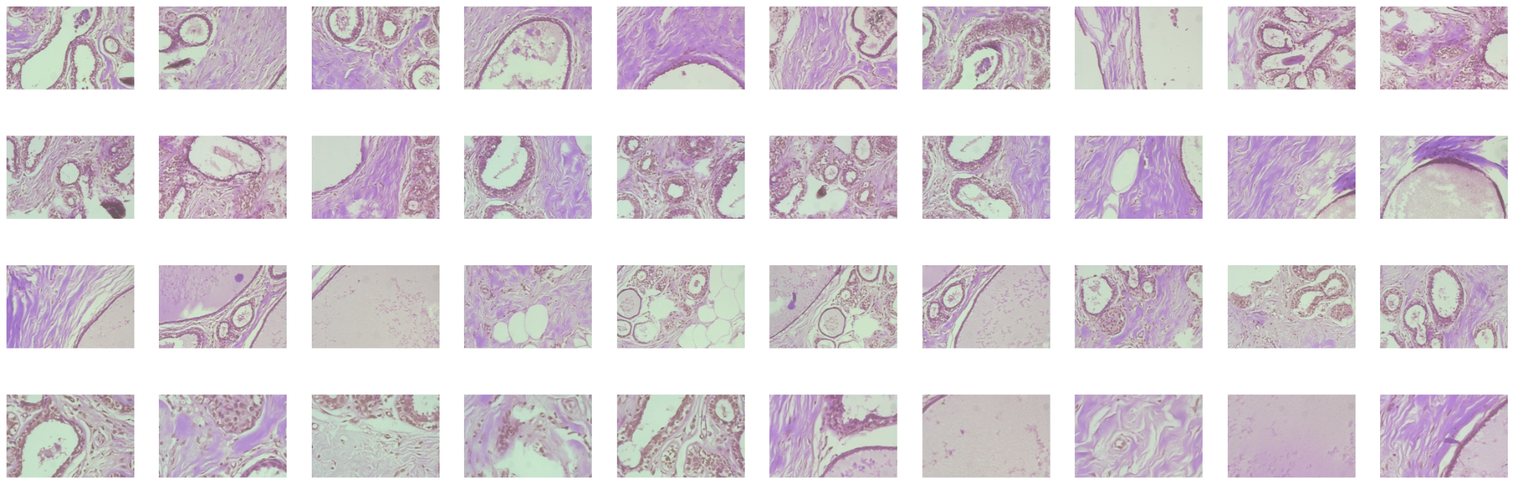
Can You Tell the Difference?
Which is benign and which is malignant?

Slide 11
Correct Labels
Malignant
Benign

Slide 12
Round 2
Which Subtypes Are These?
Categories:
Adenosis, Phyllodes Tumor, Fibroadenoma, Tubular Adenoma, Carcinoma, Lobular Carcinoma, Mucinous Carcinoma, Papillary Carcinoma?

Slide 13
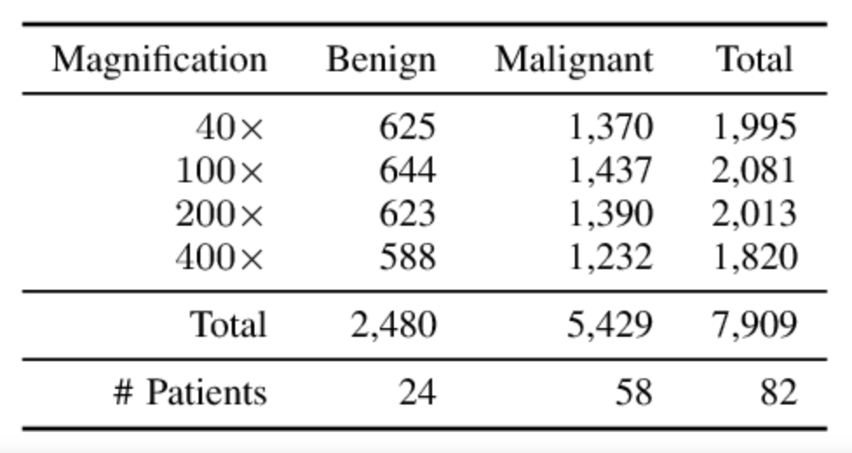
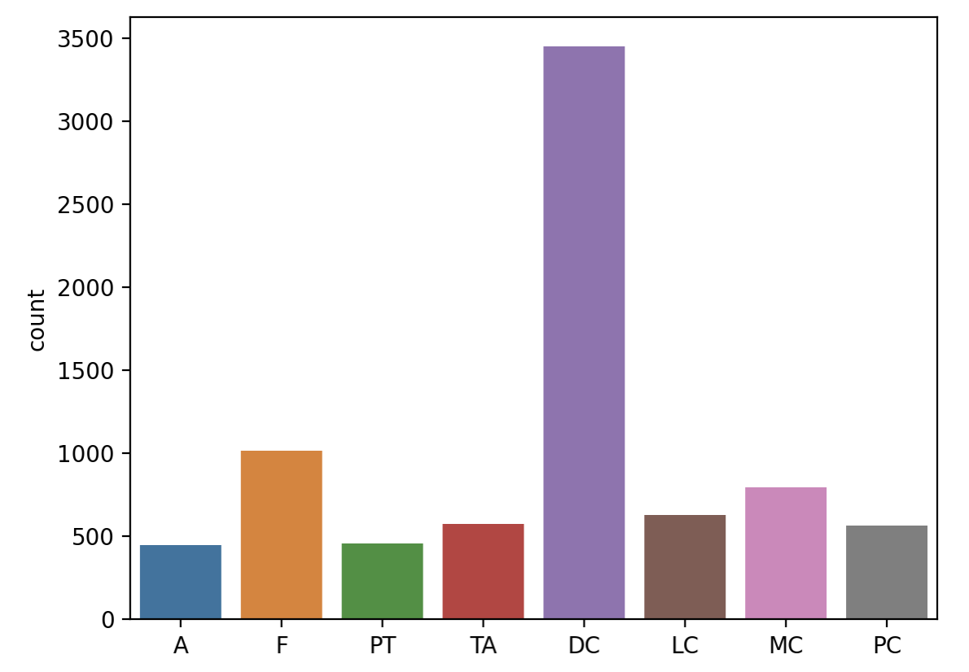
Data Set Label Composition
Unbalanced Categories: Malignant / Ductal Carcinoma
Sub Classes

Slide 14
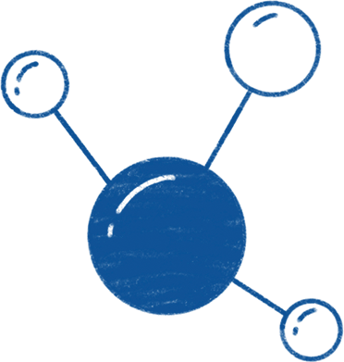
Current Situation & Problems
Current situation
Difficult to classify and accurately monitor the presence and progression of cancer tumors
Time Intensive
Discrepancy In Consensus
Variation from Preparation
Pathologist Training: MD and 3 year residency
Technician Training: Associate Degree
Consensus around classifications from pathologist hover around 70 - 80 %
The procedure for creating the microscope biopsy slides can vary from hospital to hospital and the personal that handles the tissue. The equipment used will also cause image artifacts

Slide 15

02
Data Prep
You can describe the topic of the section here

Slide 16
Dataset Curation
Tumor Type Classification
Binary Labels
Benign vs Malignant
8 unique tumor types
Magnification
Image Path
Tensor Dataset
40x to 400x
Directories
Tensor Dataset and Slices

Slide 17
Study objectives
Assisted Diagnostic Tool
Cost Effective
A reliable model with good accuracy and precision to help medical professionals
Low computational cost to augment and create image datasets
High Throughput
Risk factors
Predictive feature for new images
Model drift

Slide 18
03
Feature Selection
You can describe the topic of the section here

Slide 19
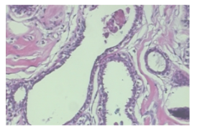
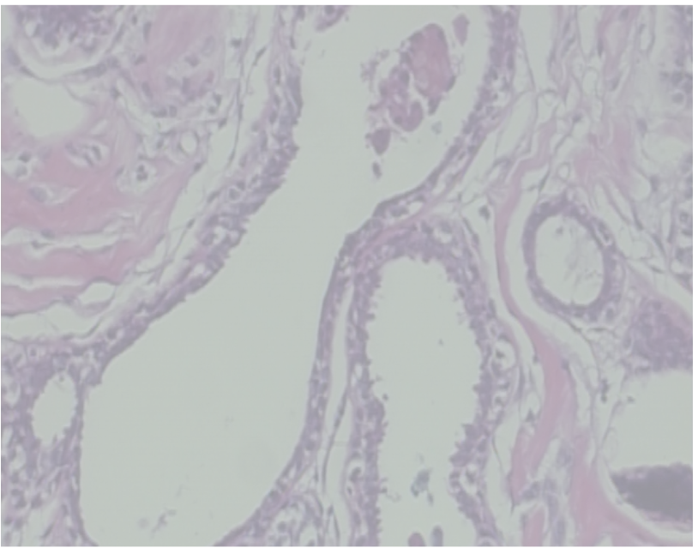
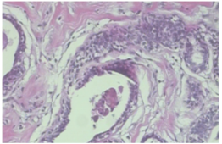
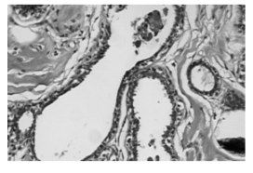
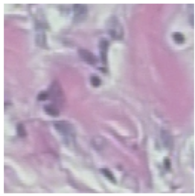
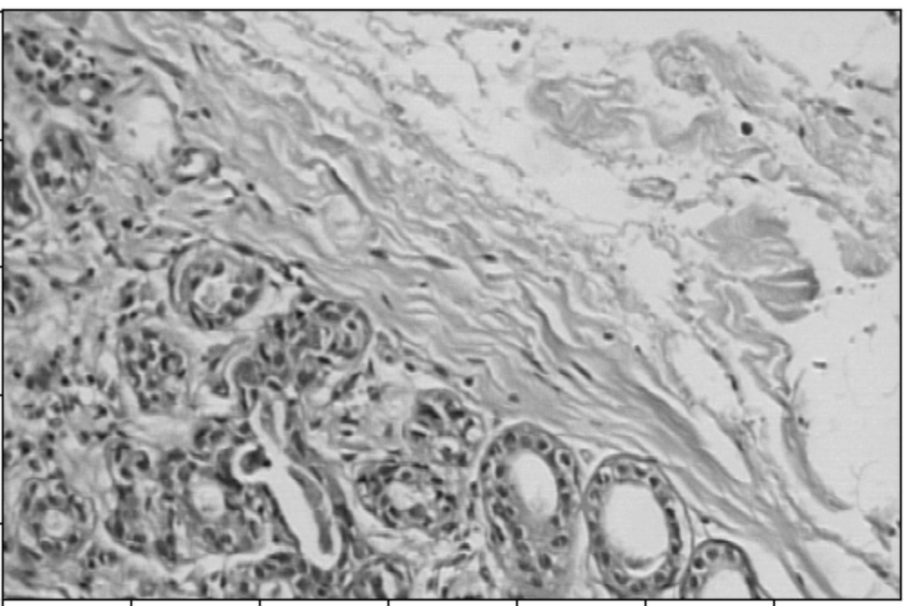
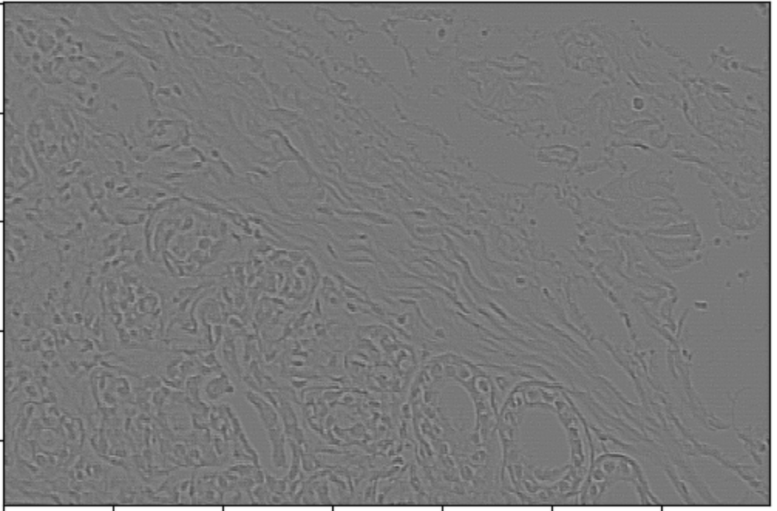
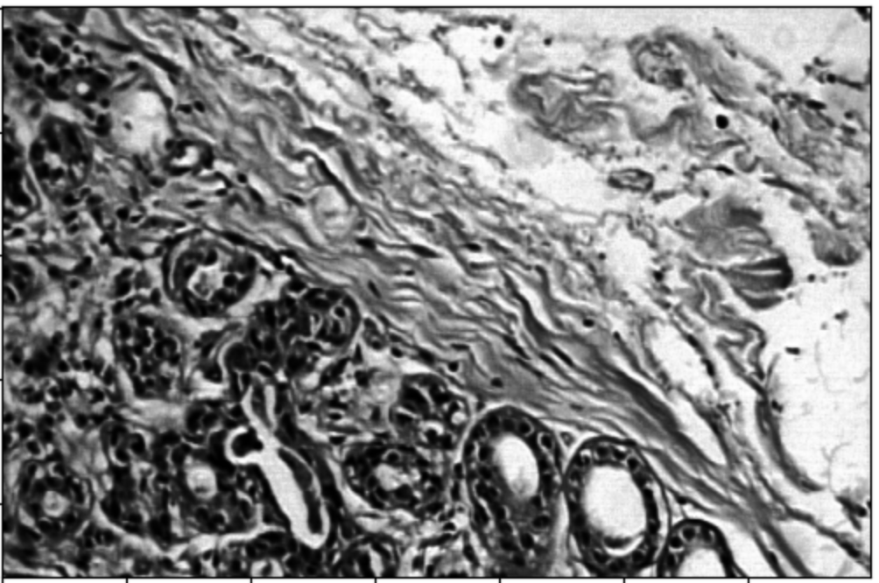
Image Augmentations
Color Augmentation
Resize
Contrast
Transpose
Rotation
OG image (460,700, 3)
(460, 700, 1)
(120, 120, 3)
Clipped Image
Sharpen
Equalization
Linear Contrast
Horizontal Flip
Vertical Flip
Zoom
20 to 90 degree rotations
RGB vs Grayscale

Slide 20
04
Models
Binary vs Multiclass- classification

Slide 21
Model Overview
01
02
03
CNN
ResNet
Random Forest
Using the provide TensorFlow package and libraries. We used convolutional layers to filter and train the pre-processed images of tumors.
Similar to CNN, our ResNet model utilizes the convolution layer from tensorflow with the addition of a ReLU layer and BatchNormalization.
Using the sub-classification between Benign and Malignant tumors we can use the Random Forest Classifier to determine entropy scores for determining of the 8 tumor types.

Slide 22
Model Overview
01
02
03
CNN
ResNet
Multiclass CNN
Using the provide TensorFlow package and libraries. We used convolutional layers to filter and train the pre-processed images of tumors.
Similar to CNN, our ResNet model utilizes the convolution layer from tensorflow with the addition of a ReLU layer and BatchNormalization.
Using the sub-classification between Benign and Malignant tumors we used different entropies and adjusted our models using softmax activation.

Slide 23
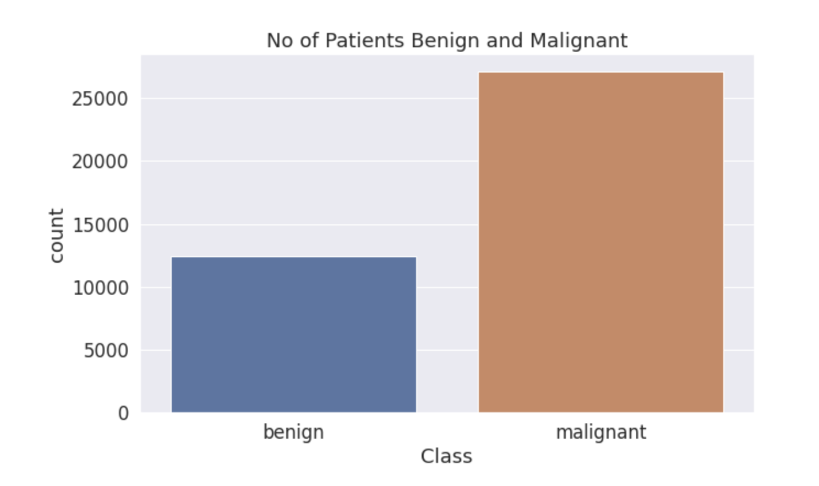
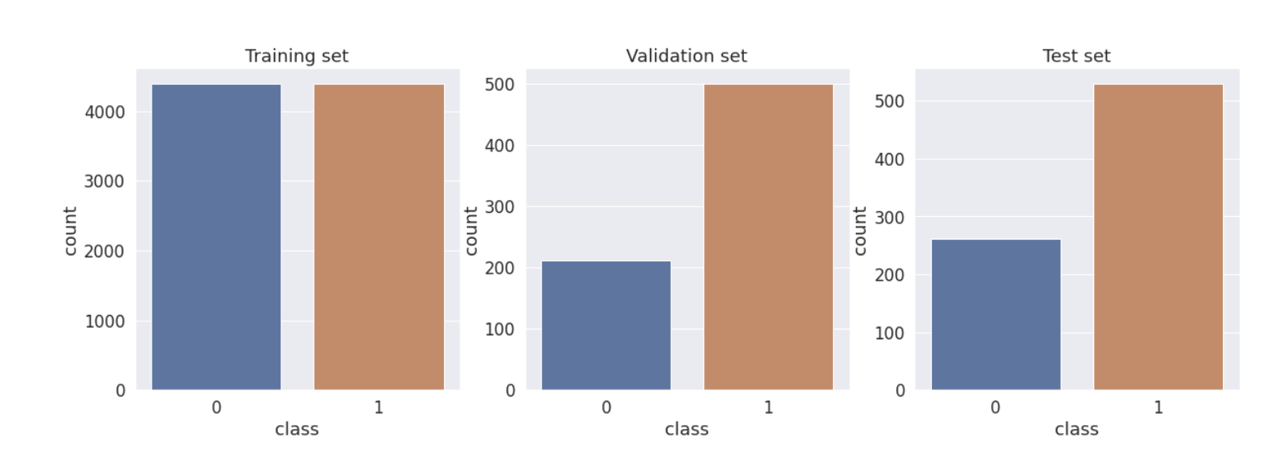
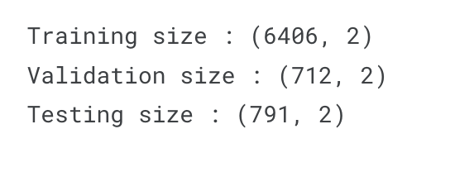
Convolution Neural Networks
Train/Test/Val Split and Upsampling

Slide 24
Convolution Neural Networks
Using Image Data Generator
Image Data Generator expects the Images to be in the following structure:
Train
Benign
Malignant
Validation
Benign
Malignant
Testing
Benign
Malignant
We defined Image Data Generator with following functions:
Random rotation by 20 degrees.
Horizontal flip.
Vertical flip.
Rescale image by its pixel value.
Randomly Zoom image by 20%.
Random shear by 20%.
Notes:
Generates batches of tensor image data with real-time data augmentation.
Thus CNN sees new set of images with different variation at each epoch.
One of the useful methods to prevent the model from Overfitting.

Slide 25
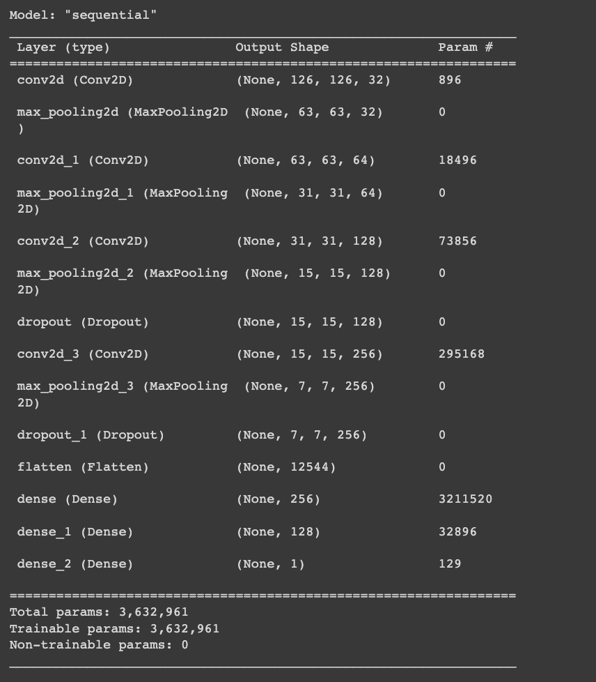
Convolution Neural Networks
CNN Architecture
CNN architecture is defined using Conv2D layers and Maxpooling layers.
Dropout Layers to prevent from overfitting.
Flatten layer is added at the end to form Dense Layers.
relu is used as activation in all the layers and Sigmoid as the activation in the output layer.
Notes:
Dropout Layers are added to randomly turn off some neurons while training to prevent from overfitting.

Slide 26
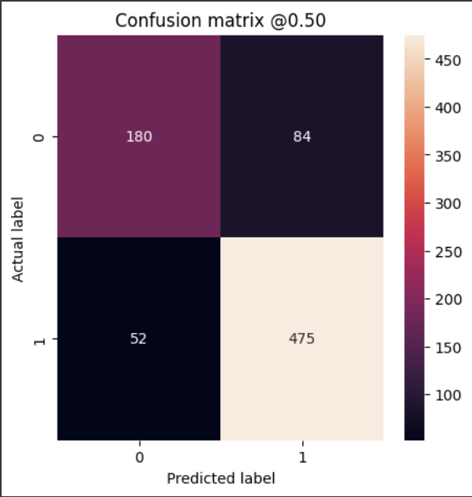
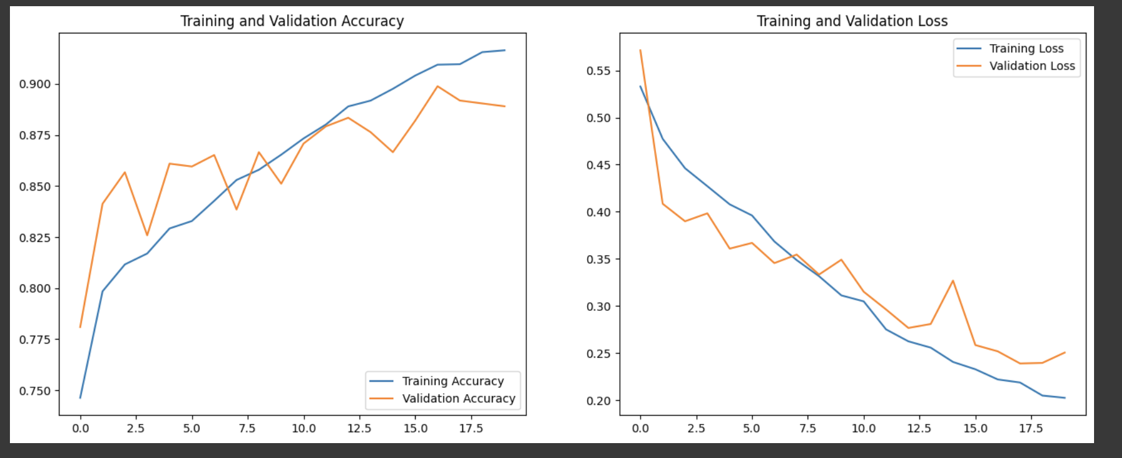
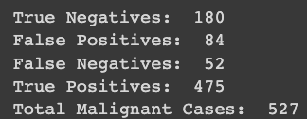
Convolution Neural Networks
Results
91 Percent Accurate

Slide 27
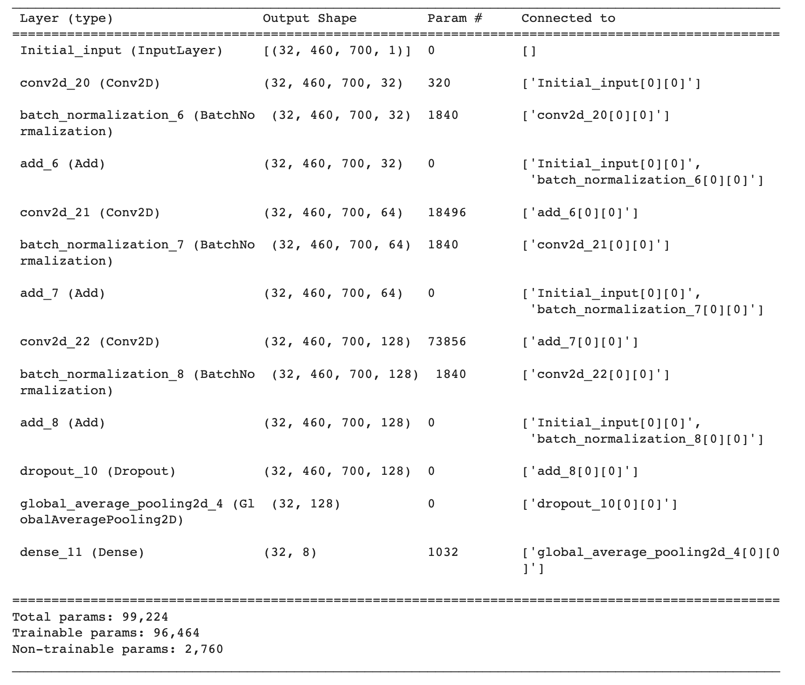
ResNet Neural Network
Tumor Types (8 encoded classes)
Benign
Adenosis, Fibroadenoma, Tubular Adenoma, Phyllodes Tumor
Malignant
Ductal Carcinoma, Lobular Carcinoma, Mucinous Carcinoma (colloid), Papillary Carcinoma
Model Architecture
Input
Convolution
Activation
Batch Normalization
Global Averaging
Softmax
Categorical Cross Entropy

Slide 28
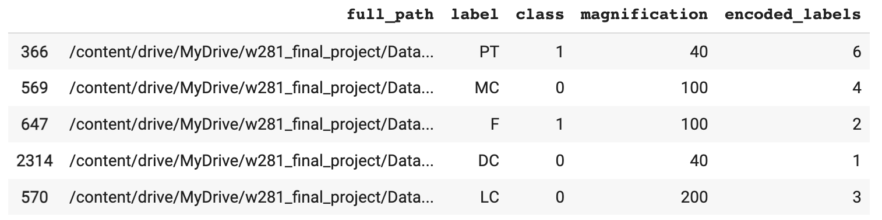
Multiclass Convolution Neural Networks
Data Preparation
To separate the individual tumor types from our combined dataset we used a Label Encoder to fit the unique tumor values to a Sparse Representation and One-Hot Encoded an array of the labels.
We processed our images in similar ways as our Binary CNN models.
Image Loading
To extract the images from our initial dataset we created a TensorFlow Dataset, converted and mapped the image paths into grayscale tensor images, and performed our image augmentations to create an image dataset with the correct corresponding labels.
Datasets
Train Set
Validation Set
Test Set

Slide 29
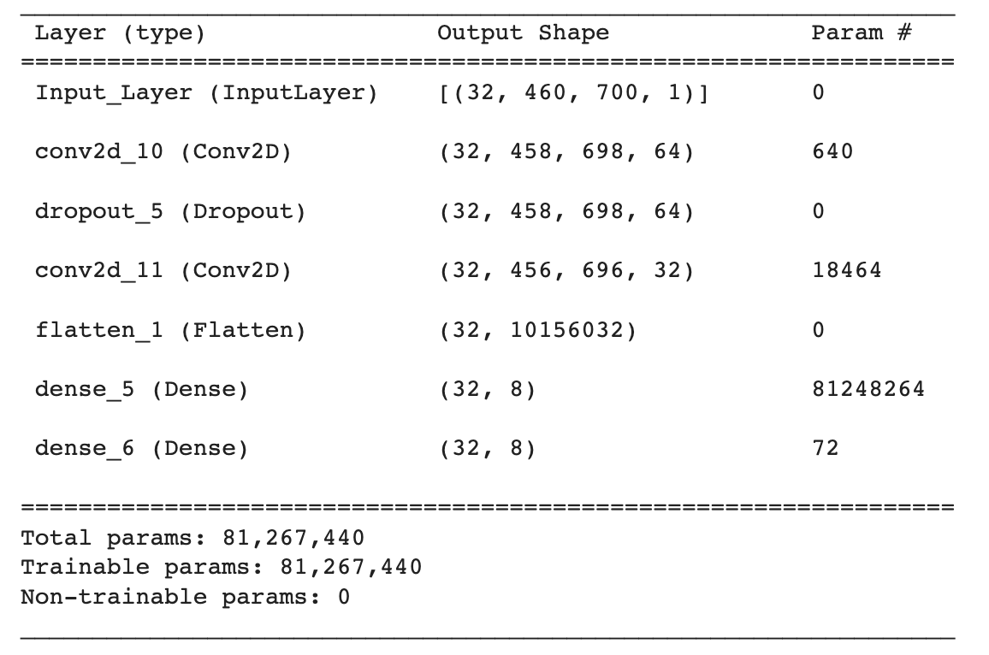
Multiclass Convolution Neural Networks
Tumor Types (8 encoded classes)
Benign
Adenosis, Fibroadenoma, Tubular Adenoma, Phyllodes Tumor
Malignant
Ductal Carcinoma, Lobular Carcinoma, Mucinous Carcinoma (colloid), Papillary Carcinoma
Model Architecture
Input
Convolution
Average or Max Pooling
Softmax
Categorical Cross Entropy

Slide 30
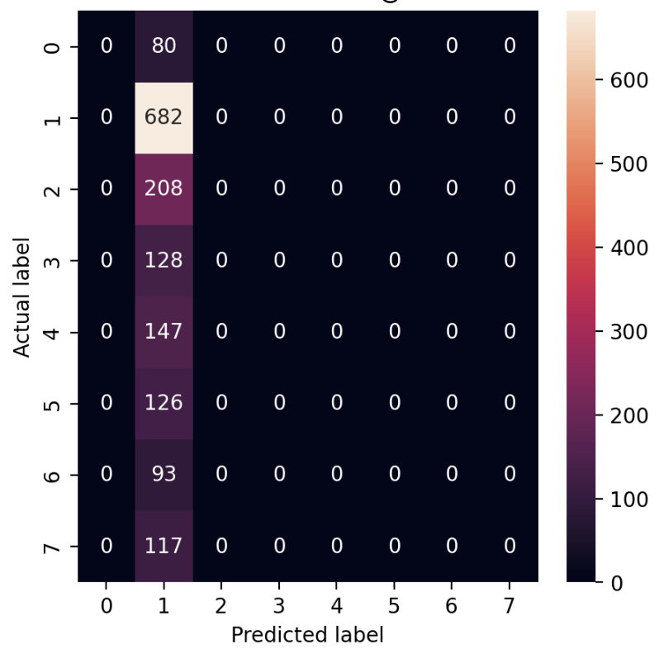
Multiclass Convolution Neural Networks
Results
Trained on unbalanced dataset
Accuracy ~ 50%
Loss 1.5680

Slide 31
Random Forest Classifier
Tumor Types (8 encoded classes)
Benign
Adenosis, Fibroadenoma, Tubular Adenoma, Phyllodes Tumor
Malignant
Ductal Carcinoma, Lobular Carcinoma, Mucinous Carcinoma (colloid), Papillary Carcinoma

Slide 32
05
Discussion

Slide 33
Troubleshooting
Tensorflow
RAM Capacity
Image Sizing
Model Parameters
Run Time

Slide 34
06
Conclusion

Slide 35
Future Development
Continued Training
Implementation
With continued research, funding, and images, models can be built to run on higher capacity servers with faster results.
The use of advanced image processing techniques from SWIN and CLIP research may benefit the quality of images and results.
Models may integrate a processing step to track the movement of tumors combined with edge detection to monitor the progression or regression of tumors.
Models may be used for initial screening of cancers to assess the severity of tumors.
Help doctors with the diagnostics and treatment plan of cancers.

Slide 36
Thank You!
Questions?

